Slide 1


Miner’s Coffee
Miner’s Coffee
A Powerful and Accessible GPU Mining Software

Slide 2

CONTENTS
1 Background
2 Structure
3 Testing
4 Demo
5 References

Slide 3
Miner’s Coffee
Background
Problem
Solution
PART 01

Slide 4

Background
Rapid Growth
Since the end of 2020, the price of Bitcoin (BTC) has been increasing rapidly. This sharp rise has stimulated the whole market of cryptocurrencies.

Slide 5
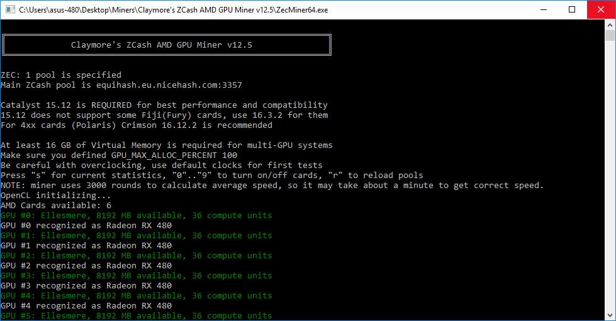
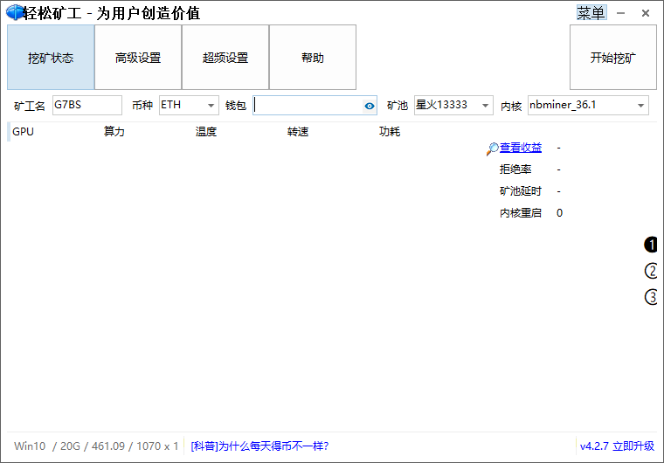
Problems
User
Unsatisfactory User
Experiences
Expensive Commission
Insufficient Functionalities
unfriendly
Commercial programs take 1-5 percent of mining output as their commission, which could be a significant loss for users in the long run.
Functionalities of commercial software are insufficient.
GUI of commercial software lacks convenience.
Open-source mining programs has no GUI

Slide 6
Solutions
Unsatisfactory User
Experiences
Expensive Commission
Insufficient Functionalities
Powerful Utilities
GPU Monitoring
GPU Overclocking
Statistics
Output Estimation
Warnings and Suggestions
Auto Overclocking
One-time Charge
No commission
More economical in the long run
Joyful User Experience
Graceful GUI
Line charts, gauges, and more
Easy, economical, and elegant

Slide 7
Miner’s Coffee
Software
Architecture
PART 02

Slide 8
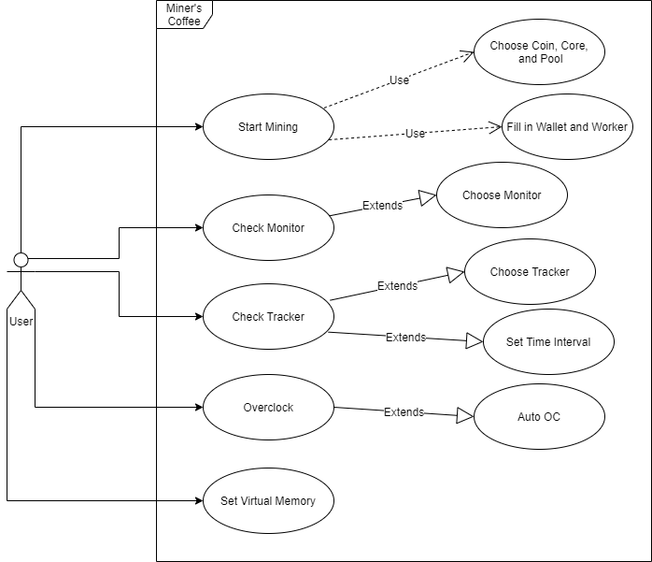
Use Case Diagram

Slide 9
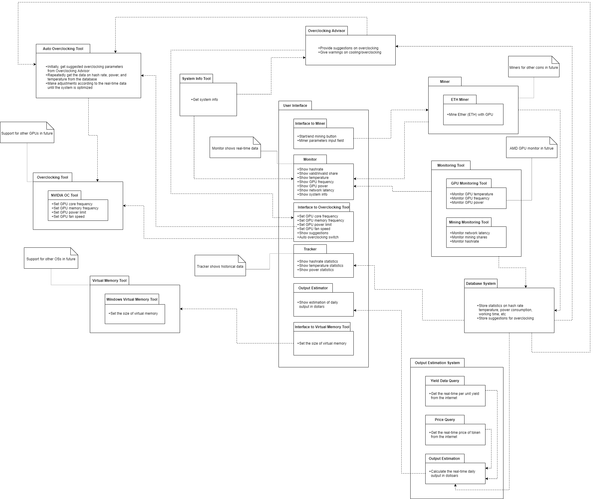
Conceptual View

Slide 10
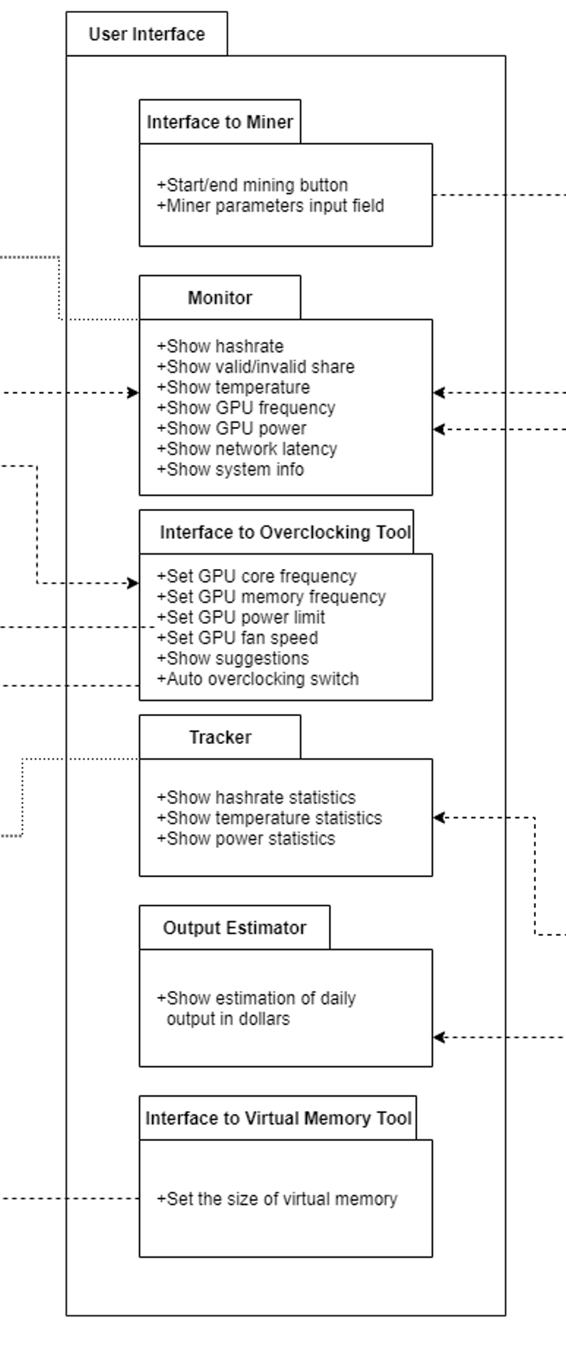
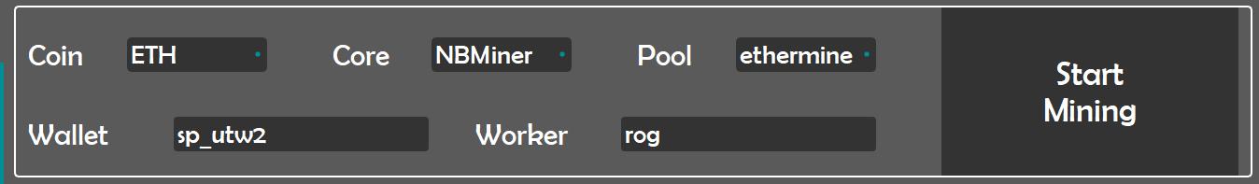
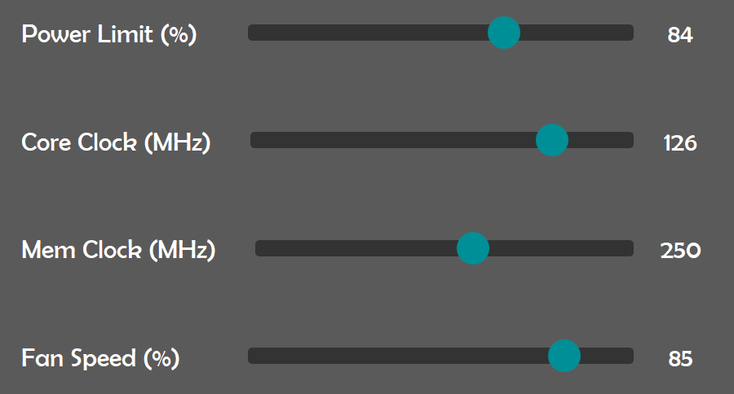
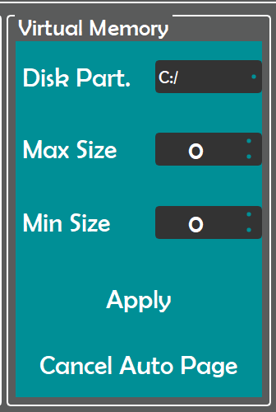
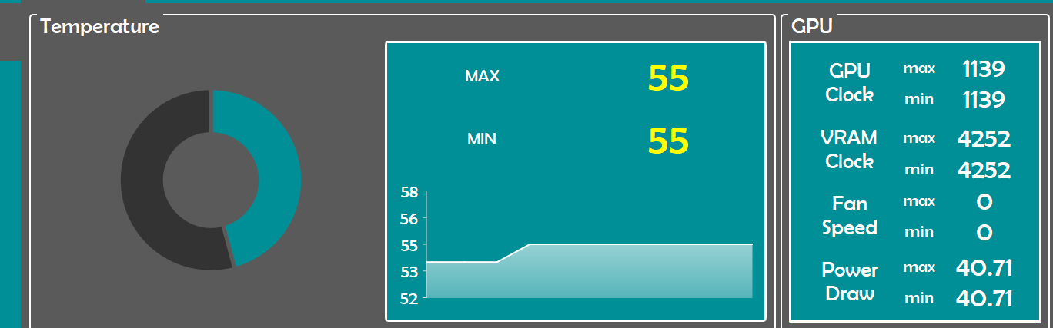
Conceptual View

Slide 11
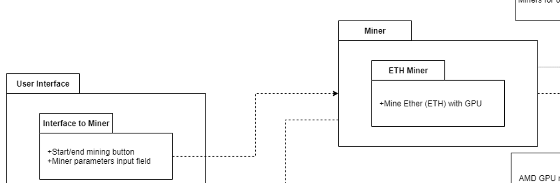
Conceptual View

Slide 12
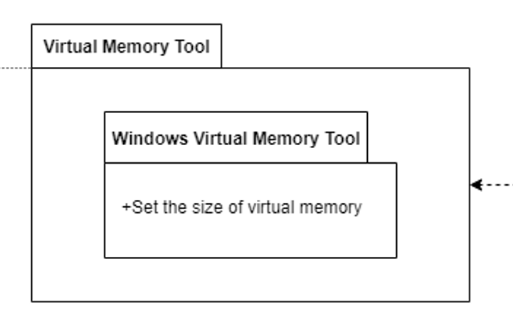
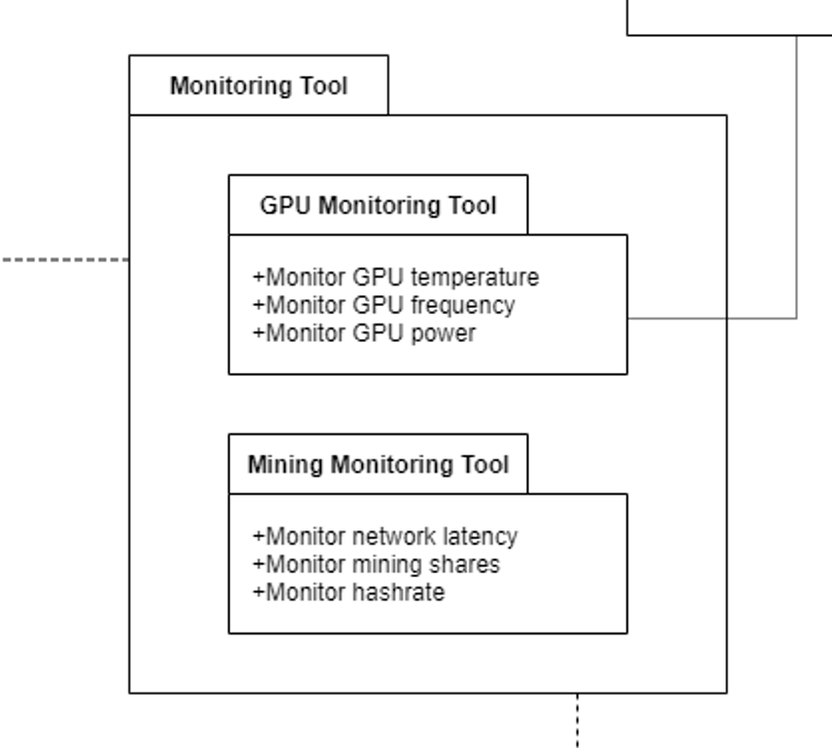
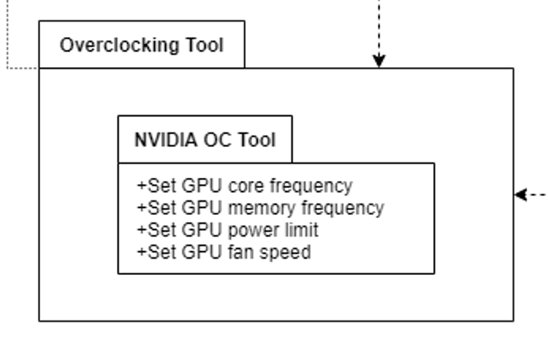
Conceptual View

Slide 13
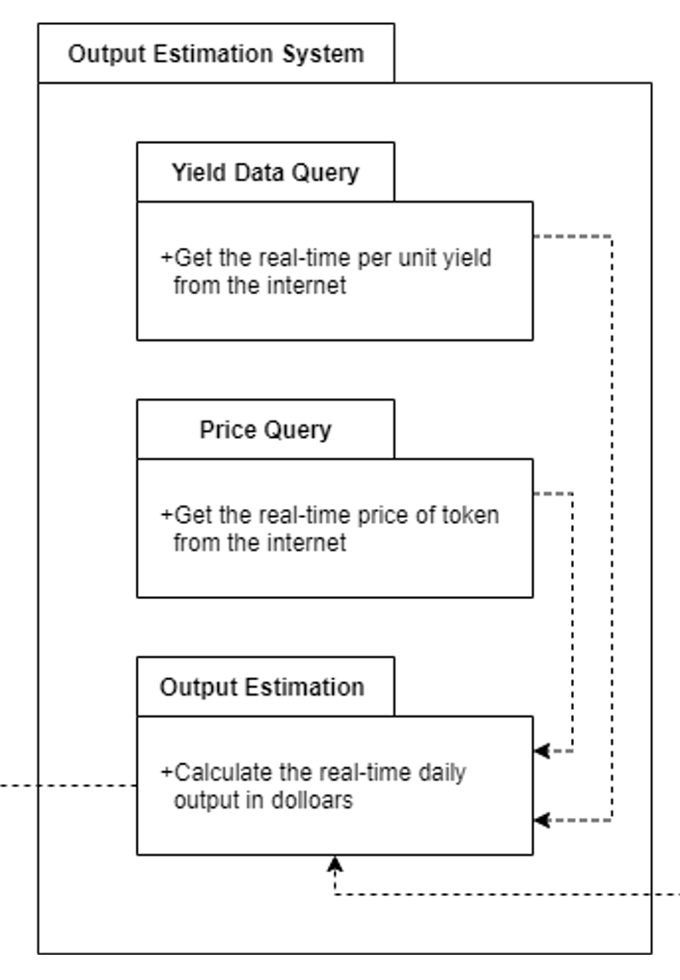
Conceptual View

Slide 14
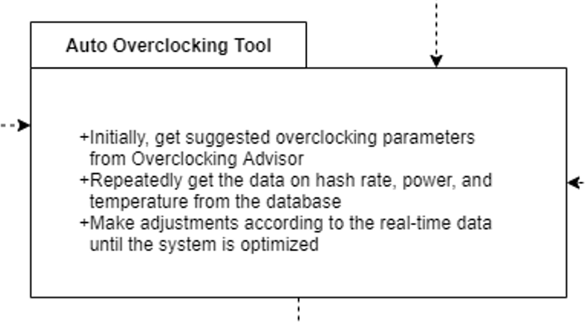
Conceptual View

Slide 15
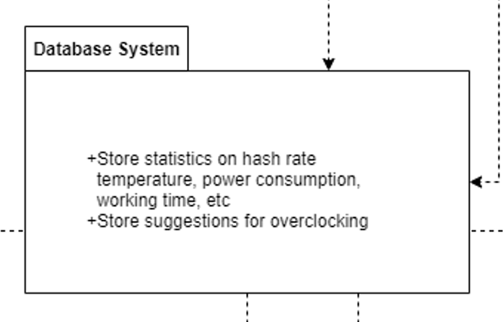
Conceptual View

Slide 16
Miner’s Coffee
PART 03
Testing

Slide 17
Testing Overview
01
Test Automation
02
Basic Testing
03
Other Testing

Slide 18
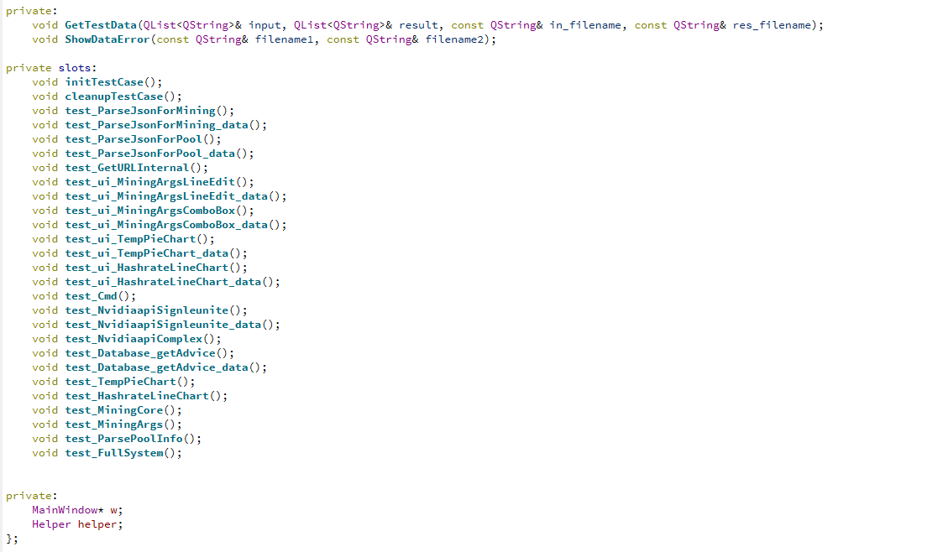
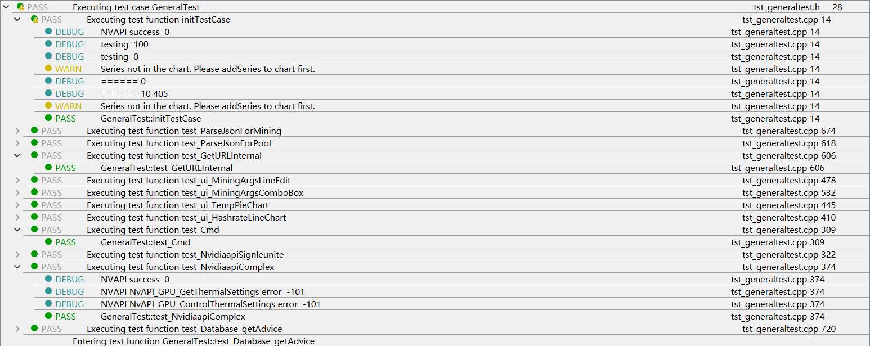
Testing Automation
QTestLib:
QTestLib is a unit testing framework provided by Qt for programs or libraries written on Qt. QTestLib provides the basic functionality of the unit testing framework and provides extended functionality for GUI testing.

Slide 19
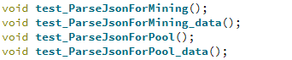
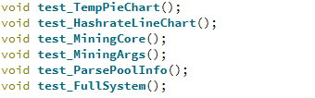
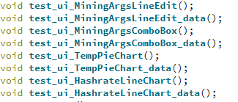
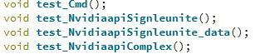
Basic Testing Structure
Unit Test for Backend
Full System Test
Component Test
and
Subsystem Test
Unit Test for UI
Unit Test for API

Slide 20
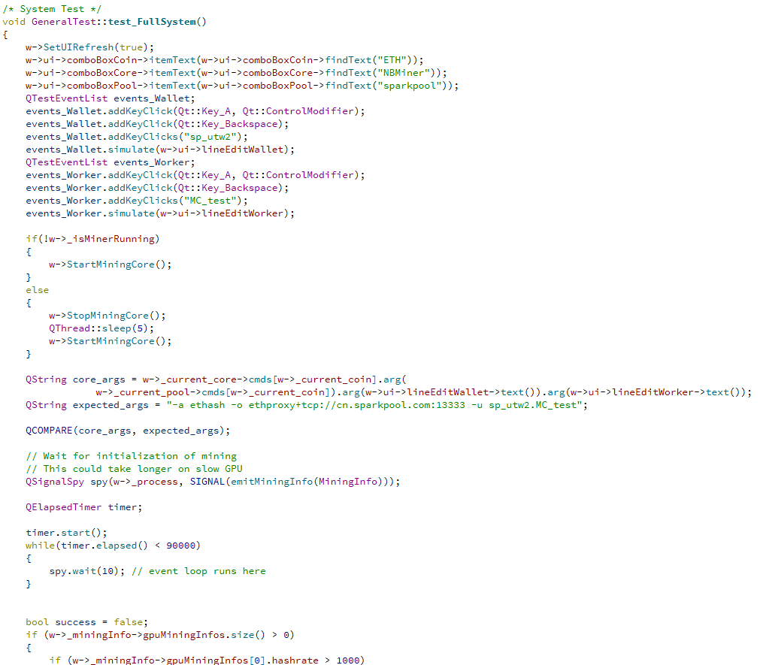
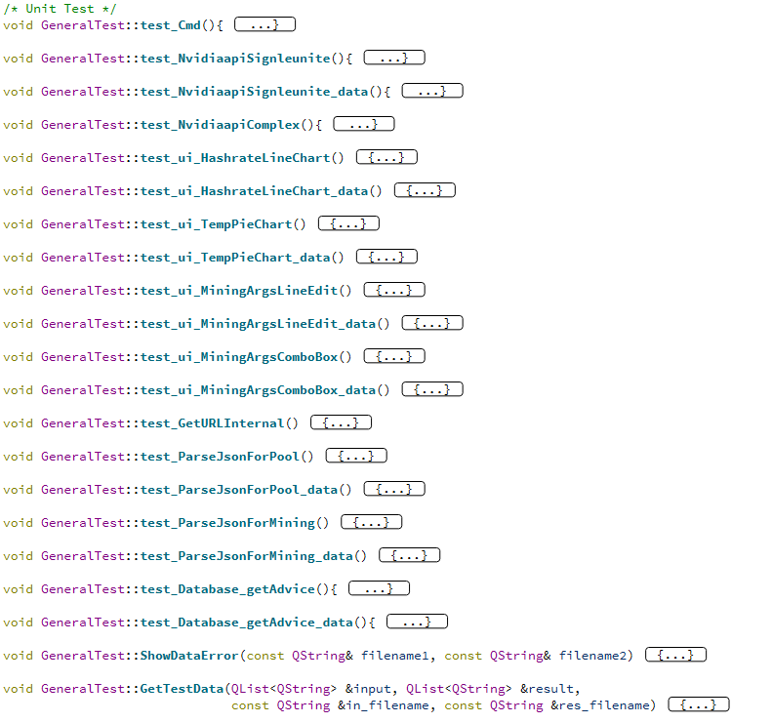
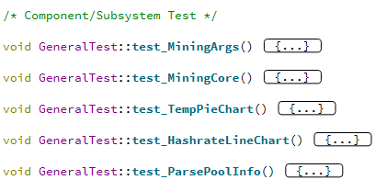
Advanced Basic Testing
For the function of each module and between the modules, we also chose the test architecture learned in class to deconstruct the test
System Test
Conponent Test
Unit Test
1
2
3

Slide 21
Non-functional Testing Parameters
Security
Flexibility
Thanks to sqlite, we don’t need users’database password to access to database.
The term refers to the ease with which the application can work in different nvidia hardware.
Non-functional
ANALYSIS

Slide 22
Miner’s Coffee
PART 04
Demo

Slide 23
Demo Display

Slide 24
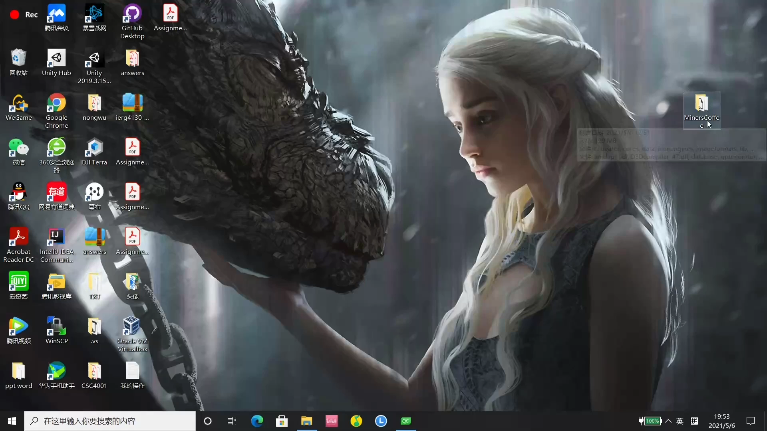

Slide 25




Project members
Ma Haotian
Mao Yu
118010220
118010224
Wu Wei
Zhang Shiqi
118010336
118010416

Slide 26
Reference
Picture from page 5 Open Source Programs retrieved from : https://help.poolin.com/
hc/zh-cn/articles/360038625812-EasyMiner%E8%BD%BB%E6%9D%BE%E7%9F%BF%
E5%B7%A5%E6%8C%96%E7%9F%BF%E6%95%99%E7%A8%8B
Picture from page 5 Commercial Software retrieved from : https://cool-mining.com/
en/mining-en/nbminer-v33-4-nvidia-amd-gpu-miner-for-eth-rvn-grin-beam/v

Slide 27
Miner’s Coffee
Q&A
PART 05

